Slide 1


By: Kamila Lerner, Oludare Ishola, Moshood, Sunday,
Zhechun(James), and Wei

Slide 2
Detailed Design
and
Implementation

Slide 3
Design Class Diagram

Slide 4
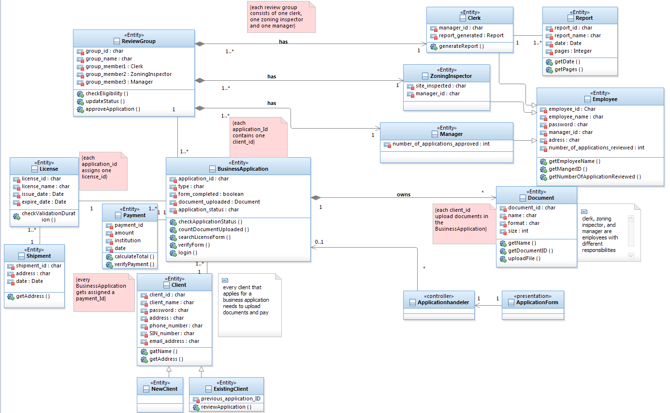

Slide 5
Java syntax

Slide 6
Client class
public class Client {
private String client_id;
private String client_name;
private String password;
private String address;
private String phone_number;
private String SIN_number;
private String email_address;
public void getClient_name() {
return this.client_name;
}
public void getAddress() {
return this.address;
}
public void setPassword(){
Scanner Sc = new Scanner (System.in);
password= Sc.nextLine();
}
public void setPhone_number() {
Scanner Sc = new Scanner (System.in);
phone_number= Sc.nextLine();
}
}

Slide 7
login function - BusinessApplication class
public class Login {
public void run() {
Scanner scan = new Scanner (new File("the\\dir\\myFile.extension"));
Scanner keyboard = new Scanner (System.in);
String user = scan.nextLine();
String pass = scan.nextLine(); // looks at selected file in scan
String inpUser = keyboard.nextLine();
String inpPass = keyboard.nextLine(); // gets input from user
if (inpUser.equals(user) && inpPass.equals(pass)) {
System.out.print("your login message");
} else {
System.out.print("your error message");
}
}
}

Slide 8
uploadFile function - BusinessApplication class
public class FileUpload extends HttpServlet {
protected void doPost(HttpServletRequest request, HttpServletResponse response)
throws ServletException, IOException {
boolean isMultipart = ServletFileUpload.isMultipartContent(request);
if (isMultipart) {
// Create a factory for disk-based file items
FileItemFactory factory = new DiskFileItemFactory();
// Create a new file upload handler
ServletFileUpload upload = new ServletFileUpload(factory);
try {
// Parse the request
List items = upload.parseRequest(request);
Iterator iterator = items.iterator();
while (iterator.hasNext()) {

Slide 9
FileItem item = (FileItem) iterator.next();
if (!item.isFormField()) {
String fileName = item.getName();
String root = getServletContext().getRealPath("/");
File path = new File(root + "/uploads");
if (!path.exists()) {
boolean status = path.mkdirs();
}
File uploadedFile = new File(path + "/" + fileName);
System.out.println(uploadedFile.getAbsolutePath());
item.write(uploadedFile);
}
}
} catch (FileUploadException e) {
e.printStackTrace();
} catch (Exception e) {
e.printStackTrace();
}
}
}
}

Slide 10
checkEligibility function- ReviewGroup class
public class checkEligibility{
public void checkEligibility(){
int age;
boolean file_uploaded;
String answer;
Scanner sc=new Scanner(System.in);
System.out.print("What is your age?");
age=sc.nextInt();
Scanner sc2= new Scanner(System.in);
System.out.print("Did you upload the file?");
answer=sc2.nextInt();
if (answer =="yes"){
file_uploaded== true;
}else{
file_uploaded== false;
}
if(age>=18)&& (file_uploaded== true){
System.out.println("You are eligible to apply");
}else{
System.out.println("You are not eligible to apply");
}
}
}

Slide 11
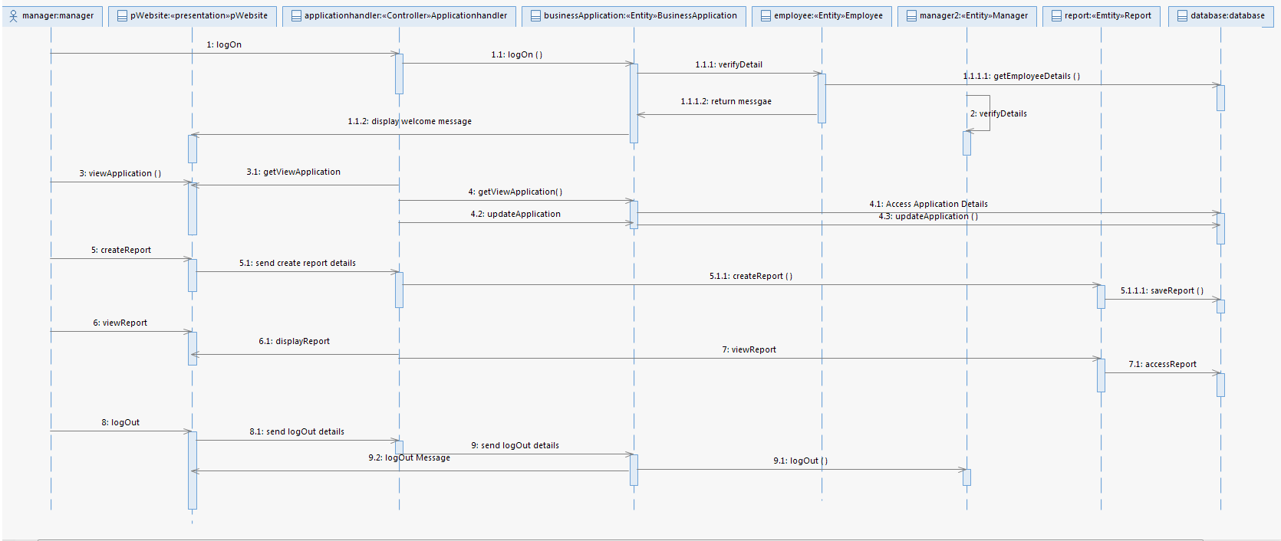
Sequence Diagram
Manager
Uses Cases
Logon
View Application
Approve Application
Create Report
Create Account
LogOut
Check Status
Update status
Submit form
Notify Client

Slide 12
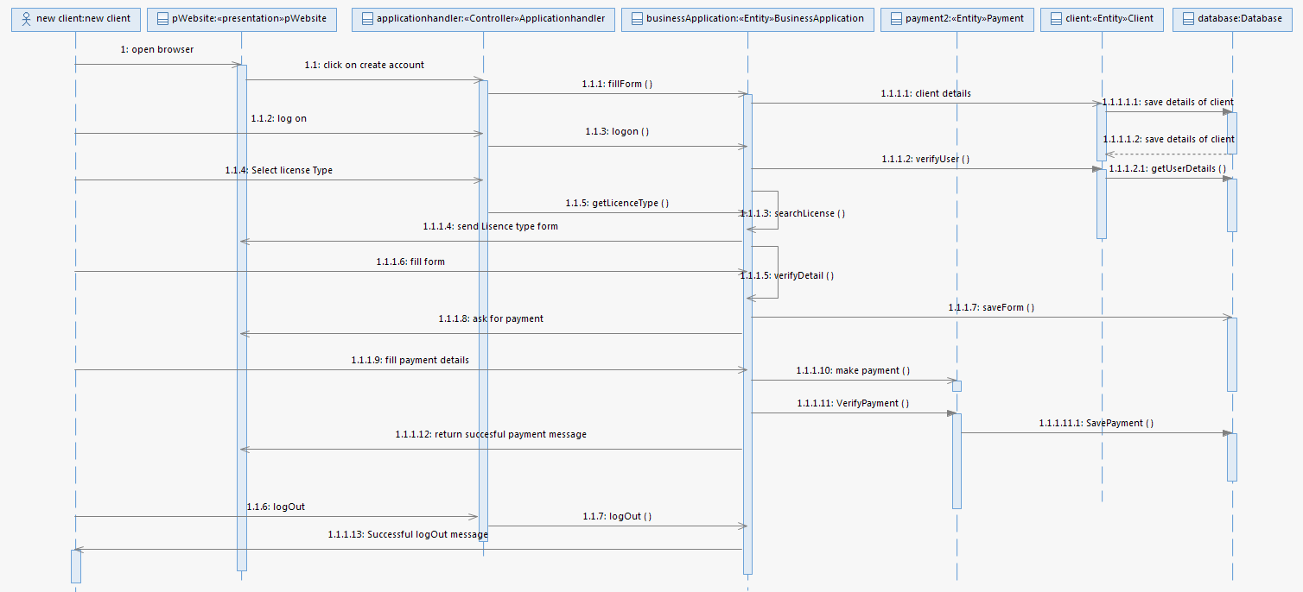
New Client
Use Cases
Create Account
Logon
Fill form
Select License
Upload document
Submit Form
Make payment
Logout
Modify Apllication
Review Application
Check Status

Slide 13
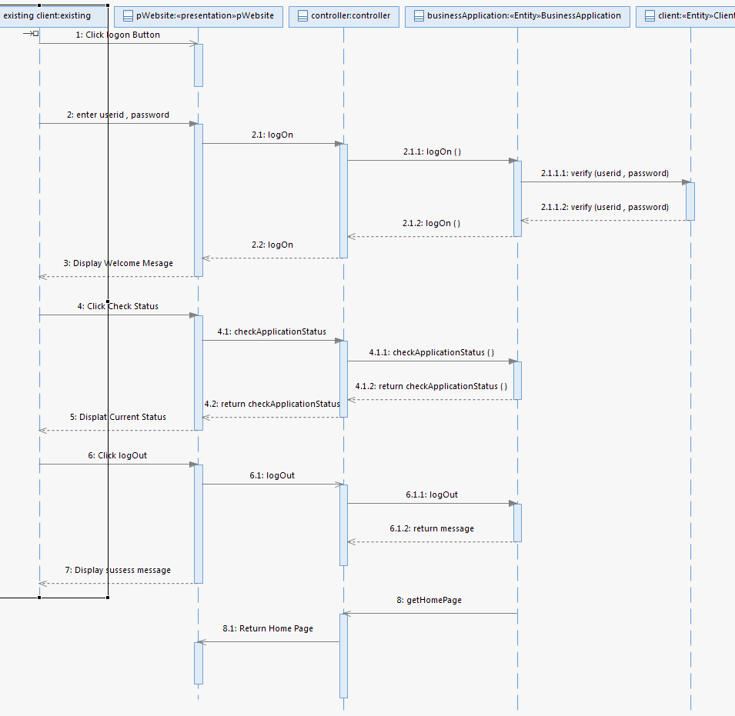
Existing Client
Use Cases
LogOn
Check Status
LogOut

Slide 14
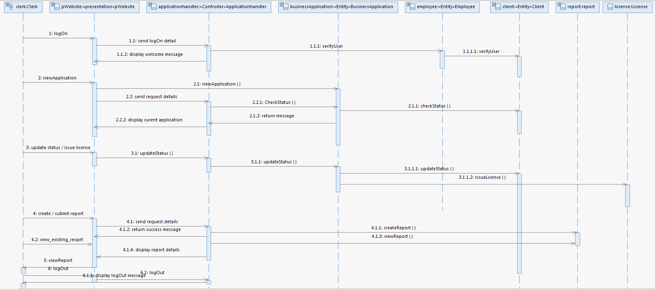
Clerk
Uses Cases
View Report
Create Report
Issue License
Update Status
Check Status
View Application
Log In
Log Out

Slide 15
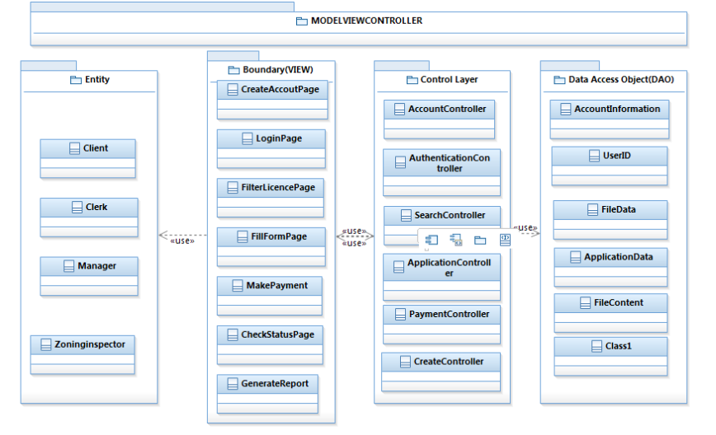
System Complexity: Layers and Partitions (BCED Approach)

Slide 16
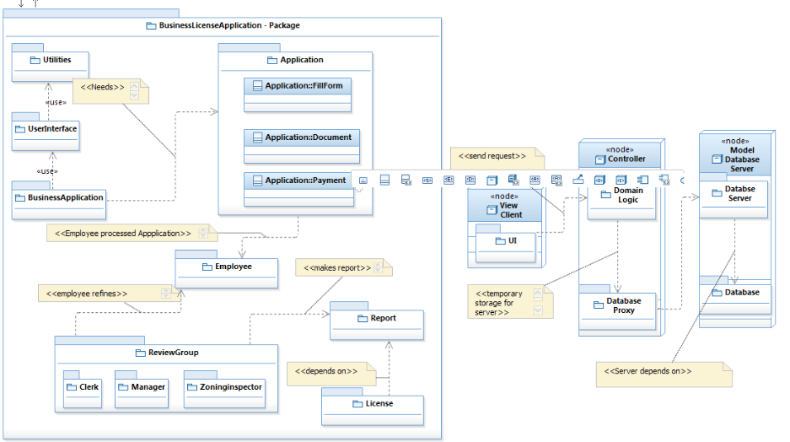
System Complexity: Package Diagram

Slide 17
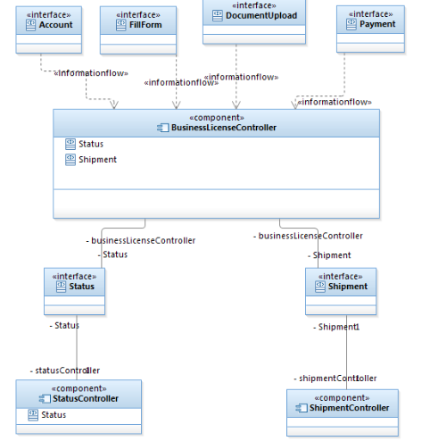
System Complexity: Component Diagram

Slide 18
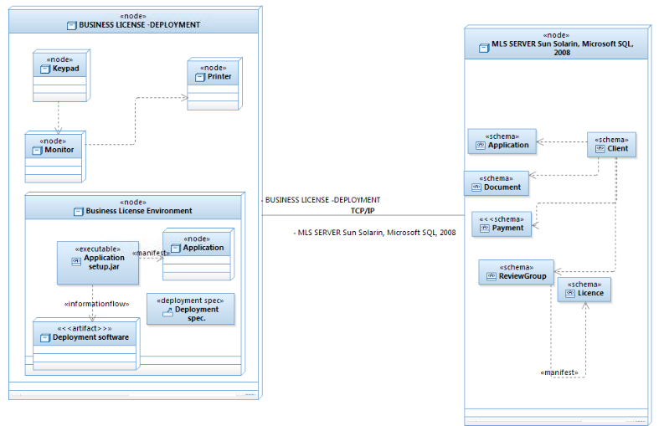
System Complexity: Deployment Diagram

Slide 19
Prototype demo

Slide 20
Website demo

Slide 21
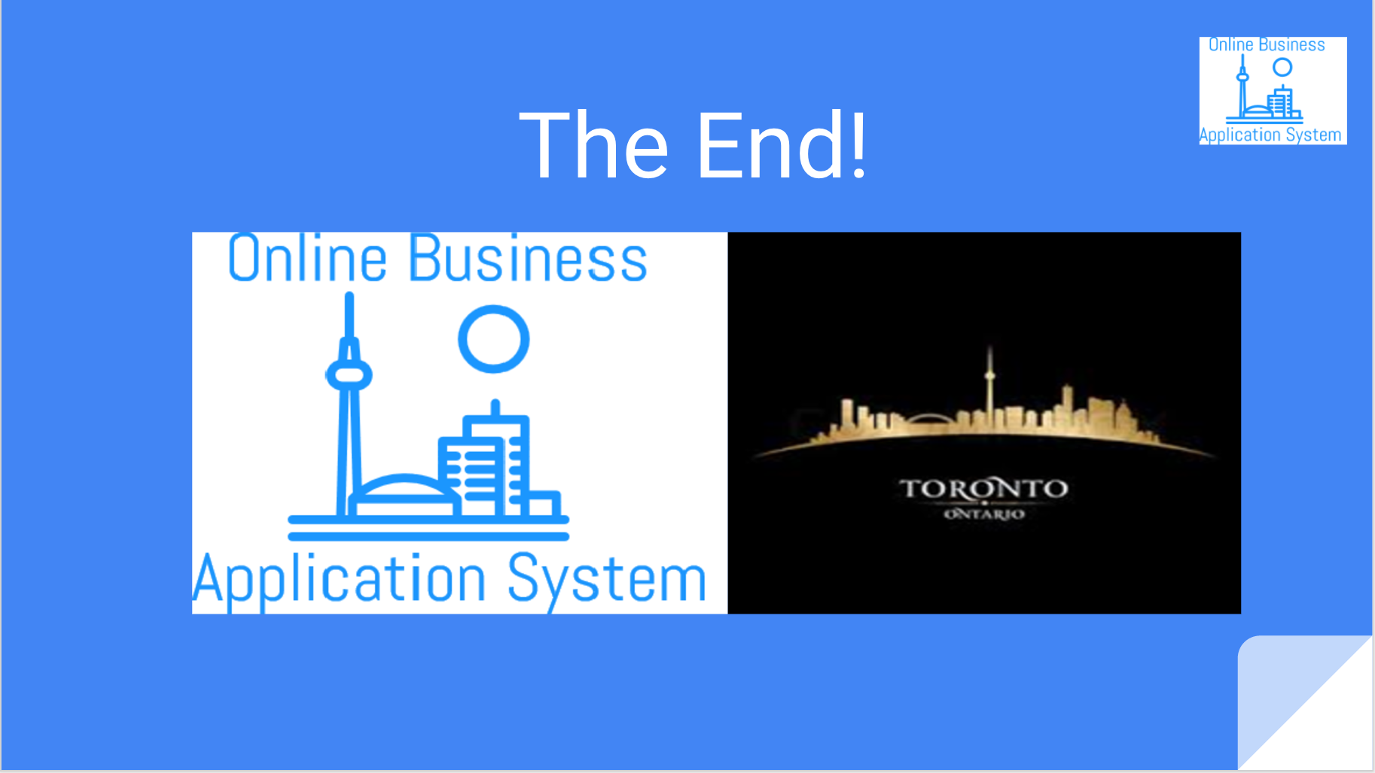
Thank you

